Slide 1
Lecture 16: IP addressing
(Subnetting)

Slide 2
Subnet Mask
An IP address has 2 parts:
The Network identification.
The Host identification.
Frequently, the Network & Host portions of the address need to be separately extracted.
In most cases, if you know the address class, it’s easy to separate the 2 portions.

Slide 3
Subnet Mask (Cont.)
With the rapid growth of the internet & the ever-increasing demand for new addresses, the standard address class structure has been expanded by borrowing bits from the Host portion to allow for more Networks.
Under this addressing scheme, called Subnetting, separating the Network & Host requires a special process called Subnet Masking.

Slide 4
Subnet Mask (Cont.)
The subnet masking process was developed to identify & extract the Network part of the address.
A subnet mask, which contains a binary bit pattern of ones & zeros, is applied to an address to determine whether the address is on the local Network.
If it is not, the process of routing it to an outside network begins.

Slide 5
Subnet Mask (Cont.)
The function of a subnet mask is to determine whether an IP address exists on the local network or whether it must be routed outside the local network.
It is applied to a message’s destination address to extract the network address.
If the extracted network address matches the local network ID, the destination is located on the local network.

Slide 6
Subnet Mask (Cont.)
However, if they don’t match, the message must be routed outside the local network.
The process used to apply the subnet mask involves Boolean Algebra to filter out non-matching bits to identify the network address.

Slide 7
Boolean Algebra (Cont.)
In another words, the only way you can get a result of a 1 is to combine 1 & 1. Everything else will end up as a 0.
The process of combining binary values with Boolean Algebra is called Anding.

Slide 8
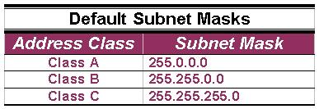
Default Standard Subnet Masks
There are default standard subnet masks for Class A, B and C addresses:

Slide 9
Filtering
Subnet masks apply only to Class A, B or C IP addresses.
The subnet mask is like a filter that is applied to a message’s destination IP address.
Its objective is to determine if the local network is the destination network.

Slide 10
Filtering (Cont.)
The subnet mask goes like this:
If a destination IP address is 206.175.162.21, we know that it is a Class C address & that its binary equivalent is: 11001110.10101111.10100010.00010101

Slide 11
Filtering (Cont.)
We also know that the default standard Class C subnet mask is: 255.255.255.0 and that its binary equivalent is:
11111111.11111111.11111111.00000000

Slide 12
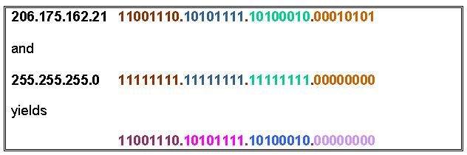
Filtering (Cont.)
When these two binary numbers (the IP address & the subnet mask) are combined using Boolean Algebra, the Network ID of the destination network is the result:

Slide 13
Filtering (Cont.)
The result is the IP address of the network which in this case is the same as the local network & means that the message is for a node on the local network.

Slide 14
Routing IP Addresses
When you build a network, you need to figure out how many network Ids your network requires.
To do so, you must account for every WAN connection & subnet on the Network.
Every node & router interface requires a Host address, or ID.

Slide 15
Routing IP Addresses (Cont.)
There’s no hard & fast rule on how you should dole out your allotted IP addresses.
Commonly, though, the lowest numbers (1 through 10) are assigned to routers & servers but how you assign addresses is strictly up to you & your network policies & guidelines.

Slide 16
Credit:
peter.joseph.smith@tafensw.edu.au

